Slide 1
Module 14: Analytics Security
Analytics: Server Architect (Siebel 7.7)
Notes:
Time: Lecture: approximately 45 minutes; labs: see Lab Guide for timings.
Intent: To explain the basic principles of analytics security in a standalone environment. Describe how to configure object-level security.
Flow: Define Siebel Analytics security capabilities, describe authentication and authorization, define the different levels of security, describe Job Manager, implement object-level and data-level security, and discuss considerations.
Key Terms:
Siebel Analytics Security
Authentication
External database authentication
Authorization
Object-level security
Data-level security
Security Manager
User
Repository group
Web catalog group
Permissions
Privileges
14

Slide 2

Module Objectives
After completing this module you will be able to:
  Define authentication and authorization
  Describe the different levels at which security is enforced
  Configure security using Security Manager
  Configure query-governing controls
Why you need to know:
  You need to set up security so the Siebel Analytics Server can authenticate users and assign appropriate permissions
Notes:
Each objective and “why you need to know” should be stated aloud. Explain that this module covers security for a standalone implementation of Siebel Analytics.

Slide 3
Business Challenge
Only qualified persons should have access rights to data-analysis applications
Data needs to be protected so that only authorized employees can access sensitive information
Employees should automatically see the information that is relevant to their roles
Notes:
If appropriate, ask students if they can think of any other challenges or concerns that would be addressed by security.
14

Slide 4
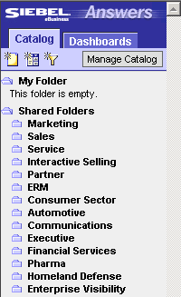
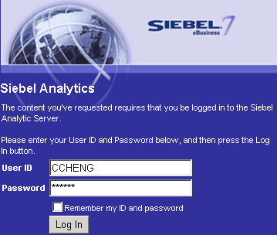
Business Solution: Siebel Analytics Security
Provides ability to authenticate users through login
Controls user access to data
Secures access control on object and data levels
The application authenticates CCHENG
The application authorizes CCHENG to view only certain folders
Notes:
This slide offers some insight into what some of the Siebel Analytics security capabilities are. Briefly discuss each bullet and describe what is occurring in the illustration. The illustration depicts the user, CCHENG, logging into the Siebel Analytics application. It is through login authentication that CCHENG is able to access the Analytics application. Authentication is covered in more detail on the following slide. The Siebel Analytics Server and Web client support industry-standard security for login and password encryption. When a user enters a User ID and password in the Web browser, the Siebel Analytics Server uses the Hyper Text Transport Protocol Secure (HTTPS) standard to send the information to a secure port on the Web server. From the Web server, the information is passed through ODBC to the Siebel Analytics Server, using Triple DES (Data Encryption Standard). This provides an extremely high level of security (168 bit), preventing unauthorized users from accessing data or analytics metadata.

Slide 5
Authentication
Process by which an application verifies that a user has the right to log in and access data
  Verification through user name and password
Supports many methods of authenticating users, including:
  Lightweight Directory Access Protocol (LDAP)
  Siebel Analytics Repository authentication
    Default method used for authentication
  Microsoft Active Directory (ADSI)
  External Database authentication
For information about authentication options, see the Authentication Options section of the Siebel Analytics Server Administration Guide.
Notes:
Authentication is the process by which a system verifies, through the use of a user name and password, that a user has the necessary permissions and authorizations to log into an application, such as Siebel Answers, and access data. Users who fail authentication verification are denied access to the application. The Siebel Analytics Server supports a number of authentication methods, some of which are listed on this slide. Siebel Analytics Repository authentication is the standard method used. When a user logs in, he or she is authenticated by the Analytics Server, using the user name and password against the list of user names and passwords stored in the Analytics Server repository. Students will have a chance to implement the External Database authentication method in the lab. Additional detail about this method is addressed in the following slide. For the remaining methods, briefly state what they are and move on. Refer students to the Bookshelf reference noted at the bottom of the slide if they want more detail on authentication methods.
14

Slide 6
Example: External Database Authentication
Maintain authentication information in an external database instead of analytics repository
  Authentication occurs when SQL queries the external database and locates a match to the user name and password submitted
Notes:
Instead of storing user names and passwords in a Siebel Analytics Server repository, an administrator can maintain lists of users and passwords in an external database table and use this table for authentication purposes. In addition to user name and password login information, the external database table can also contain other types of authentication information such as the display name, group membership, logging levels, and so on. These variables can also be used in place of user name and password. The advantage of using this method is that administrators only need to define user login information once in the external database. Whenever a user logs in, his or her user name and password is authenticated through a SQL script that queries the external database table for authentication. After successful authentication, the results of this SQL query are used to populate system session variables for the user.

Slide 7
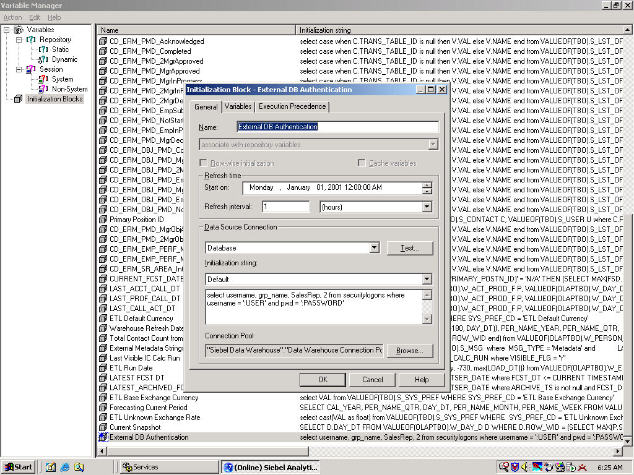
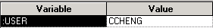
Connecting to the External Database
Authentication occurs when the external database returns a value for the USER system variable
  Initialization block is used to query against the database requesting authentication information on the USER
SQL that queries the database for authentication
External Database
Notes:
External database authentication uses Siebel Analytics session variables, which you define using the Variable Manager in the Administration Tool. Session variables get their value when a user begins a session by logging in. The variable USER, which is shown in the illustration, is used with the external table authentication. Values, returned from the database, populate the variables. It is important to note that a database will return values that meet all WHERE criteria. In the example illustrated, it is only USER and PASSWORD.
14

Slide 8
Authorization
Process by which an application verifies what a user or group is authorized to:
  View, referred to as permissions
    Defined for server and Web objects
  Perform, referred to as privileges
    Defined for Web objects only
Permissions example
Privileges example
User/Group | Permissions
User 1 | Read
User 2 | Denied
Group 1 | Full Control
User 3 | Denied
Group 2 | Read
User/Group | Privileges Granted
User 1 | Manage Privileges
User 2 | Create Folders
Web Group 1 | Create iBots, Publish iBots
User 3 | Create Folders
Web Group 2 | Create Views
Notes:
Authorization checks what the user is authorized to view and what actions he or she has a right to perform. Make sure students understand the difference between authentication and authorization. Authentication verifies a user name and password and creates a user session.

Slide 9
Siebel Analytics Security Levels
0/2
Authentication and authorization are enforced on two levels:
Object-level security
Data-level security
Notes:
This is a structuring slide. Security by which all analytic data is protected occurs within one of two levels: object-level or data-level. You will first discuss object-level security. Details are addressed in subsequent slides.
14

Slide 10
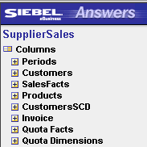
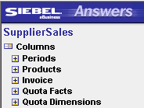
Object-Level Security
1/2
Controls access to Analytics repository objects (metadata), such as subject areas, tables, and columns
  Configured in the Siebel Analytics Administration Tool
Controls access to Analytics Web catalog objects, such as dashboards, folders, filters, views, and reports
  Configured in Analytics Web applications
User 1 session
User 2 session
User 1 is authorized to view additional folders compared to User 2
Notes:
Object-level security controls access to metadata, or repository objects, as well as some Web catalog objects. Object-level security is the focus of this module. Security for metadata objects, such as, subject areas, dashboards, tables, and columns are configured in the Analytics repository using the Analytics Administration Tool. Security for Web catalog groups are controlled using Web catalog groups accessible from the Web Analytics Administration Tool. Web catalog groups are discussed in more detail in a later slide.

Slide 11
Data-Level Security
2/2
Controls access to content that appears in end-user objects, such as dashboard reports
  Configured in the Analytics Administration Tool
Example: Monthly sales report viewed by two different users
  Columns for the reports are the same, but the data is different
Regional manager has access to all district managers and their sales reps
District manager only has access to his sales reps
Region
District
Sales Rep.
Month
Sales
Region
District
Sales Rep.
Month
Sales
May
13K
12K
Mike
May
17K
9K
Stacy
June
June
Mark
May
6K
9K
Sue
Jon
May
13K
15K
Ryan
June
Tim
June
Mike
May
17K
9K
Sue
Jon
June
Tim
May
13K
15K
June
Jen
May
7K
11K
Beth
June
Frank
May
13K
11K
June
Notes:
Data-level security controls the content that appears in the end-user objects, such as Dashboard reports and figures. When two different users run the same report, they see different data, depending on their access. In the example are two reports. The report on the left is being accessed by Sue, who is the Sales Regional Manager. In her report, she is able to access the sales data for her three subordinate district managers: Mark, Jon, and Beth. The report on the right is being accessed by the District Manager, Jon. Even though he has access to the same report as Sue (columns of his report are identical to those of Sue’s report) the data he is able to access is restricted compared to what Sue is able to access.
14

Slide 12
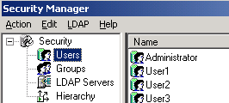
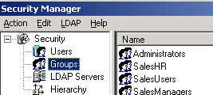
Security Manager
Provides options for defining users and repository groups
Groups allow membership to users and other groups
  Simplifies administration of large numbers of users
  Provides a set of security attributes
Users
Groups
Notes:
The Security Manager displays all security information for a repository and is located within the Siebel Analytics Administration Tool. It is here that an administrator can create and maintain a list of users, their passwords, and groups directly in the Analytics repository. A group can be thought of as a set of security attributes. Users and/or groups can be assigned to a group, thus, becoming a member of that group. Through inheritance, groups can explicitly deny or grant particular security attributes to its members. Users can belong to one or more groups. Additional capabilities an administrator can perform within the Security Manager include synchronizing LDAP users and groups, setting access privileges on objects such as tables and columns, setting filters on information, and setting up a managed query environment. For more information on additional capabilities, reference the Siebel Analytics Server Administration Guide.

Slide 13
Implement Object-Level Security
1/3
For repository objects:
Create a new user
Create a repository group
Define permissions
Notes:
This is a structuring slide for implementing object-level security for repository objects. Details are addressed in subsequent slides.
14

Slide 14
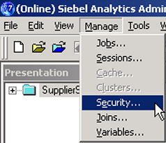
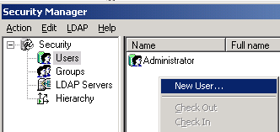
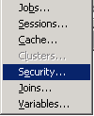
1. Create a New User
1/3
Use Security Manager, in the Administration Tool, to create a user in the repository
Select Manage > Security
Select Users
Right-click white space, select New User
Notes:
Using the Security Manager, users can be created explicitly in the repository, as shown on this slide. This is rather simple task to perform, so you may wish to demonstrate it.
When demonstrating, you will need to open the Analytics Administration Tool in online mode. As shown in the illustration, select Manage > Security. There are two ways to create a user, either demonstrate what is illustrated by right-clicking the white space or create the user from the Action menu. Students create users in the lab.

Slide 15
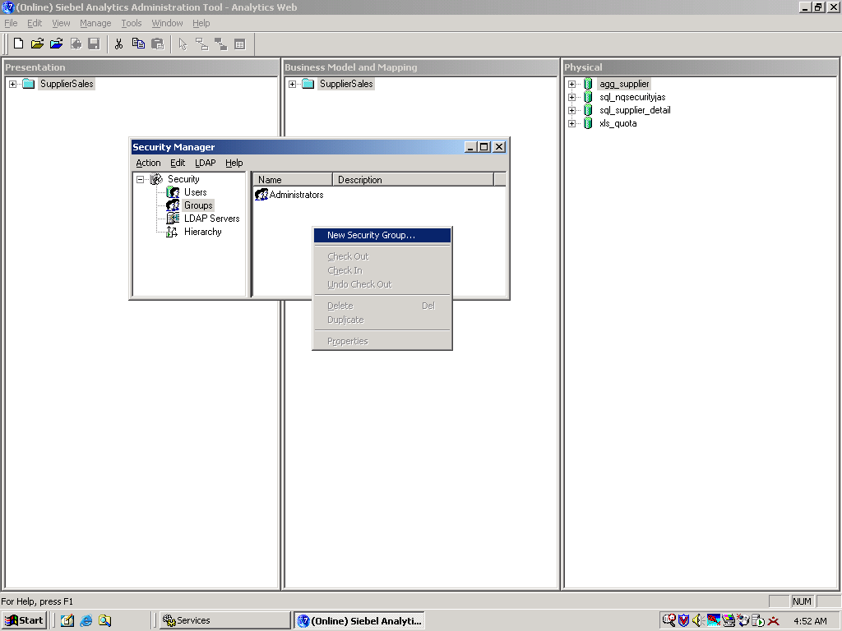
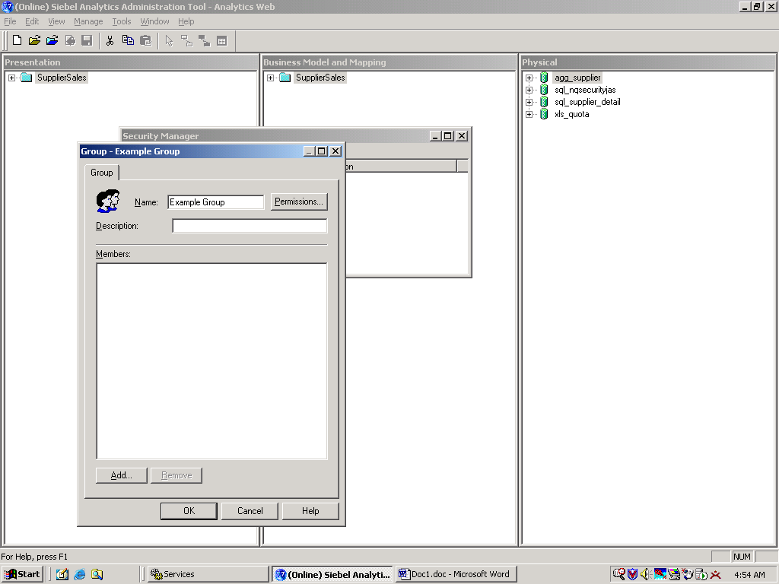
2. Creating a Repository Group
2/3
Is similar to creating users
Define group name
Right-click white space, select New Security Group
Click to add users and groups to the new group
Notes:
You may want to continue demonstrating how to create a group since it is a simple task. Also demonstrate how to add the user you created from the previous slide to this new group by clicking the Add button. Upon clicking the Add button, a list of users appears. Click the user you wish to add and click the OK button. The Everyone group is the only group that has been provided. All other groups will need to be created by the administrator in the Security Manager. By default, the Everyone group is explicitly granted access to all repository objects, unless the administrator explicitly denies access to this group. Also by default, all users and groups that the administrator creates become members of the Everyone group.
14

Slide 16
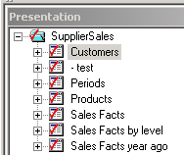
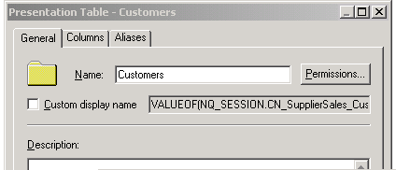
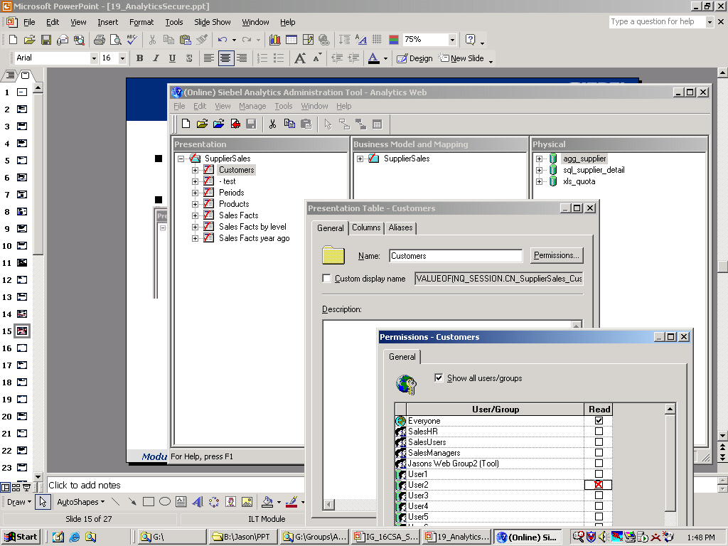
3. Define Permissions
3/3
Set permissions from the Presentation Table properties dialog box
Example: Restrict Customers, Periods, and Products access to User 2
Double-click object
Click Permissions
Click box to deny User 2 access
Default setting for all objects is Everyone
Notes:
Point out that objects in the repository (group, table, and so forth) have a Permissions button. It is within permissions that an administrator can explicitly deny or grant read access of an object to users and groups. The illustration shows that permissions are being set for the Customers table. User2 is explicitly being denied access to this table. As a result, if User2 were to log into an Analytics application, such as Siebel Answers, Customers would not appear in the catalog. However, because User1 is not explicitly denied access to the Customers table, it would appear in the catalog for User1.

Slide 17
Implement Object-Level Security
0/4
For Web catalog objects:
Create a Web catalog group
Assign users
Define permissions
Assign privileges
Notes:
This is a structuring slide for implementing object-level security for Web catalog objects. Details are addressed in subsequent slides.
14

Slide 18
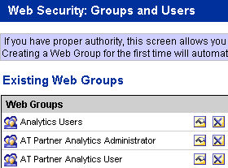
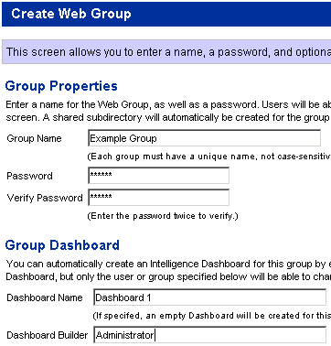

1. Create a Web Catalog Group
1/4
From Siebel Answers, select Admin > Manage Web Groups and Users to create groups
Name of Web Group should not match any name of a user
Assign either existing dashboard or create new one
Click the link to access Group definition page
User or group with rights to modify dashboard
Notes:
In order to create Web catalog groups and define permissions and privileges for those groups, a user must have administrator rights to access the Web Administration screen, the location where security is configured. To access this screen from Siebel Answers, click the Admin link. Demonstrate this by logging into Siebel Answers as Administrator, leaving the password blank. Click on the Admin link located in the top-right corner of the screen.

Slide 19
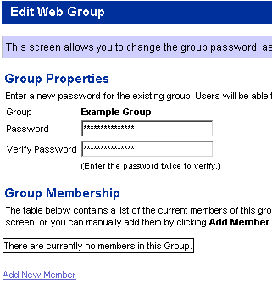
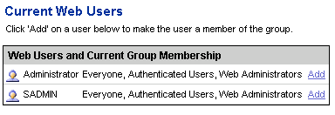
2. Assign Users
2/4
Select the Web group, in the Manage Web Groups and Users site, to assign users to a Web group
  Users are created in the repository
Displays a list of users and groups you can assign to the Web group
Click Add to assign user to the group
Notes:
It is important to point out that once users have been assigned to repository groups (shown in the previous slides), users become dynamically assigned to the same Web catalog groups, assuming the repository groups and Web catalog groups have the exact same name. Thus, this step of assigning users to Web catalog groups would not be necessary.
14

Slide 20

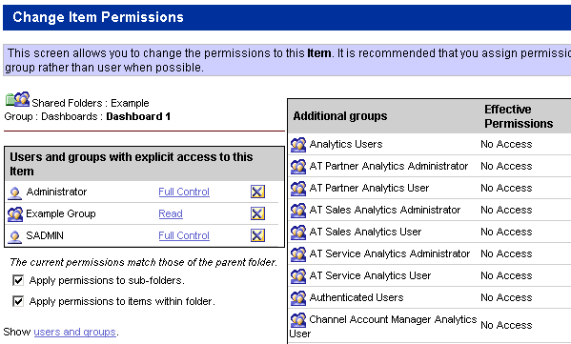
3. Define Permissions
3/4
Click the Manage Intelligence Dashboards link to define permissions
  Locate Web group you wish to define permissions for
    Permissions: Read, Change/Delete, Full Control, No Access, Traverse Folder
Click the Permissions icon
Click the link to toggle to appropriate permission
Default settings
Notes:
Similar to how permissions function for repository objects (described in an earlier slide), permissions for Web objects also govern the type of access that a user is permitted. Some examples of permissions are Read, Change/Delete, Full Control, No Access, and Traverse Folder. To configure permissions for dashboards, click the Manage Intelligence Dashboards link from the Siebel Analytics Administration screen. To configure permissions for the Analytics Catalog, click the Manage Analytics Catalog link from the Siebel Analytics Administration screen.

Slide 21
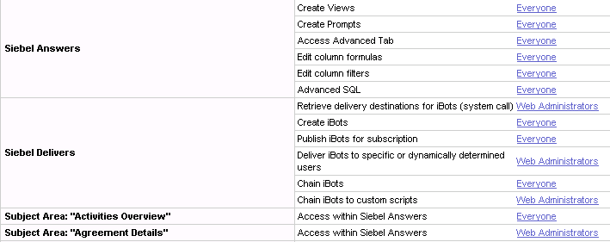
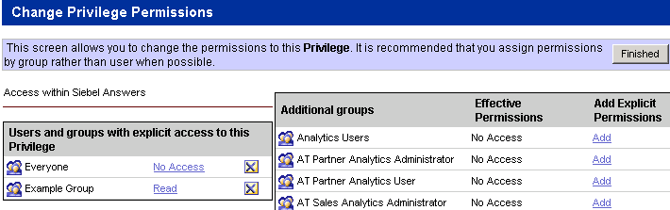
4. Assign Privileges
4/4
Click the Manage Privileges link to assign privileges
  Locate the privileges you wish to assign to users or Web groups
    Privileges: Read or No Access
Select user or group name to access the Privileges page
Notice that privileges are denied to the Everyone group and granted to the Example group
Click to give Read or No Access privileges
Notes:
In version 7.7, the Granted and Denied permissions have been replaced with Read and No Access permissions. Privileges are the actions that users have the right to perform in the Siebel Analytics Web. Privileges are managed by associating them with individual users or Web catalogs. A specific user or group is either granted or denied a specific privilege. These associations are created in privilege assignment tables. Like permissions, privileges are either explicitly set or inherited through group membership. Explicitly denying a privilege takes precedence over any granted, inherited privilege. If a user, or any Web group to which the user is a member, is not assigned a particular privilege, by default that user is denied that privilege. To configure privileges, click the Manage Privileges from the Siebel Analytics Administration screen.
14

Slide 22
Considerations
0/4
Privileges
Bypassing Siebel Analytics security
Query limits
Disable query functionality
Notes:
This is a structuring slide. Details are addressed on subsequent slides.

Slide 23
Privileges
1/4
Can be:
  Granted to users and groups explicitly
    This has precedence over privileges granted through groups
  Granted or denied to users through memberships in groups
A user that is a direct member of two or more groups, with conflicting privileges, is granted the least restrictive privileges of the groups
Notes:
This slide summarizes the conditions in which privileges can be granted or denied to users and groups. At this point, students should have a good understanding of this. Briefly explain these concepts and move on.
14

Slide 24
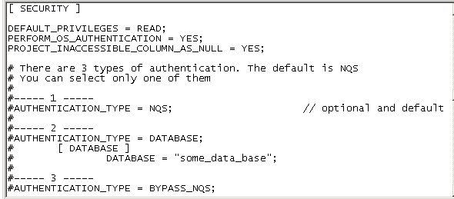
Bypassing Siebel Analytics Security
2/4
In the security section of the NQSConfig.ini file, you have the option to bypass security
  Option 3
Remove pound sign, save file, and restart the Siebel Analytics Server to implement change
Notice that the bypass authentication parameter is commented out by default
Notes:
Review the definition of authentication and some of the methods of authentication that were discussed earlier. Rather than using one of these methods, an administrator can bypass the Siebel Analytics Server security and rely on the security provided by issuing user-specific database logins and passwords when the Siebel Analytics Server submits queries to databases for authentication. The database can then determine whether the query will be performed for the user. In order to bypass Siebel Analytics Server security, an administrator will need to set the AUTHENTICATION_TYPE in the NQSConfig.INI file to BYPASS_NQS as seen in the illustration (remove the # sign before the text to activate).

Slide 25
Query Limits
3/4
Multiple queries running simultaneously can hinder performance
  May consume too many resources
  Affects performance
Administrators can set a limit on the time it takes the system to execute a query
  If a query exceeds the limit, it will terminate and free up resources
Notes:
This slide describes the purpose for using query limits. Briefly review these points and move on. Setting query limits is covered in more detail on the following slides.
14

Slide 26
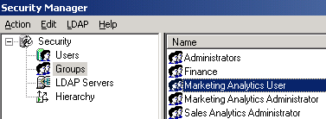
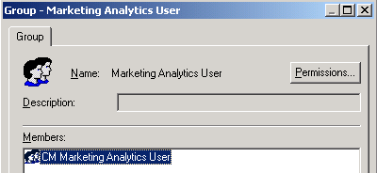
Setting Query Limits
3/4
Set query limits from Security Manager
  Limits can be set at either the user or group level
Selecting an object in the left pane will list its associated groups and users in the right pane
Double-click the object to navigate to the Group dialog box
Click Permissions to define security for all members of the group
Notes:
To avoid hindering operating performance, administrators can configure query limits to disallow queries that will consume too many resources. This is done either by setting a limit on the number of rows permitted or by setting a limit on the processing time. This is illustrated on the next slide. Students practice this in the lab, To demonstrate, from the Security Manager, select the user you wish to set limits for and then click Permissions. From there, select the Query Limits tab. At this point, move on to the next slide.

Slide 27
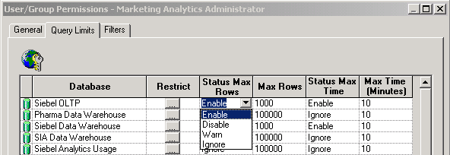
Setting Query Limits Continued
3/4
Set limit for a query based on number of rows or time
  Enable: Enforces restriction and cancels the query
  Warn: Logs message in NQServer.log and NQQuery.log if row limit is reached
  Ignore: Limits will be inherited from the parent groups
    If there is no row limit to inherit, does not enforce limit
Click ellipsis to define a disable query functionality period
Specify maximum value in field
Notes:
Query limits can be restricted based on the maximum number of rows permitted and the maximum time it takes to process a query. Once these limits are set, an administrator will need to define what the status is. Types of status are listed on the slide. Explain what each status is for. Also note that to disable any limits, set the status to DISABLE.
14

Slide 28
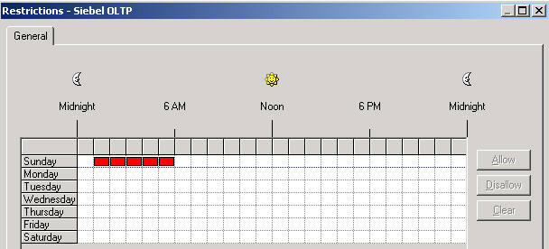
Disable Query Functionality
4/4
Prohibits users from being able to query
  Allows for other production tasks to be performed, such as batch reporting and table updating, without hindering performance
Identify the day and time for restriction and click in the box
Click to allow/disallow highlighted restriction period
Notes:
Administrators can also regulate when users will be able to query databases, preventing them from querying during times when system resources are tied up with other production tasks, such as batch reporting or table updates. The example indicates that users will not be able to query at all between the hours of 1 AM to 6 AM on Sundays.
Students practice this in the lab.

Slide 29
Summary
This module showed you how to:
  Define authentication and authorization
  Describe the different levels at which security is enforced
  Configure security using Security Manager
  Configure query-governing controls
Notes:
Review Questions:
Question: Identify some Siebel Analytic Security capabilities.
Answer: Provides ability to authenticate users through login, controls user access to data, and secures access control on object and data levels
Question: Authorization is the process by which an application verifies that a user has the right to log in to access data. True or false?
Answer: False, that is authentication.
Question: What does object-level security control and what does data-level security control?
Answer: Object-level security controls access to repository objects and some Web catalog objects. Data-level security controls data that appears in the end-user objects (such as dashboards and reports).
14

Slide 30
Lab
In the lab you will:
  Set up a new user using Security Manager
  Create new groups and add users
  Set up external database authentication
  Use Security Manager to disallow queries that consume too many resources
Notes:
Lab Tips and Troubleshooting:
See Lab Guide for details.

